Slide 1
Keys in DBMS

Slide 2
What are Keys in DBMS?
KEYS in DBMS is an attribute or set of attributes which helps you to identify a row(tuple) in a relation(table).
They allow you to find the relation between two tables.
Keys help you uniquely identify a row in a table by a combination of one or more columns in that table.

Slide 3
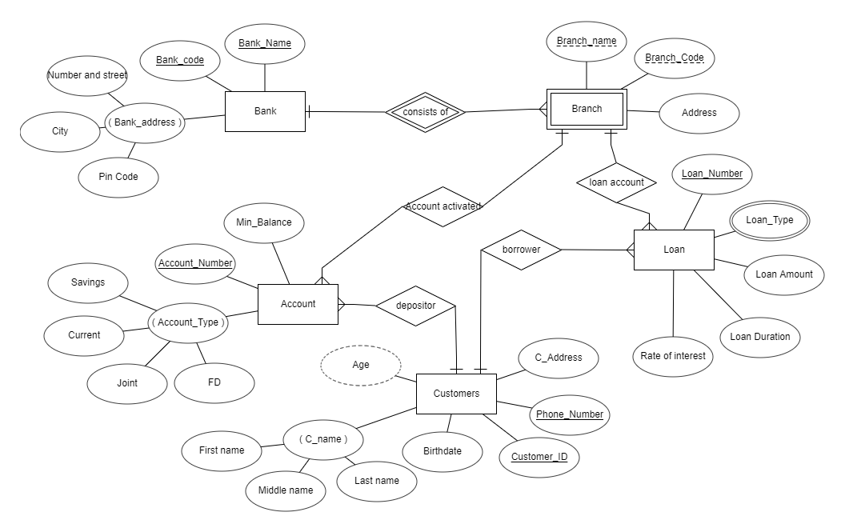

Slide 4
Name | BirthDate | Address | Phone_No | Gender | Customer_ID
ABC | 12-10-1990 | ******* | XXXXX | F | 1234
XYZ | 03-08-1994 | ******* | XXXXX | M | 5678
MNO | 12-10-2000 | ******* | XXXXX | F | 1023
ABC | 26-03-2004 | ******* | XXXXX | F | 9658

Slide 5
Why we need a Key?
Keys help you to identify any row of data in a table. In a real-world application, a table could contain thousands of records. Moreover, the records could be duplicated. Keys ensure that you can uniquely identify a table record despite these challenges.
Allows you to establish a relationship between and identify the relation between tables
Help you to enforce identity and integrity in the relationship.

Slide 6
Types of Keys in DBMS
There are mainly seven different types of Keys in DBMS
Super Key
Candidate key
Primary key
Alternative key
Foreign key
Composite key
Compound key
Surrogate key

Slide 7
What is the Super key?
A super key is a group of single or multiple keys which identifies rows in a table.
A Super key may have additional attributes that are not needed for unique identification.
Phone_No
Customer_ID
Phone_No, Customer_ID
Phone_Number, Name
Customer_ID, Name
Phone_No, Customer_ID and Name
Name | BirthDate | Address | Phone_No | Gender | Customer_ID

Slide 8
What is a Candidate Key?
A set of attributes that uniquely identify tuples in a table.
Candidate Key is a super key with no repeated attributes.
The Primary key should be selected from the candidate keys. Every table must have at least a single candidate key. A table can have multiple candidate keys but only a single primary key.
It must contain unique values
Must not contain null values
It should contain minimum fields to ensure uniqueness
Uniquely identify each record in a table

Slide 9
What is a Primary Key?
PRIMARY KEY is a column or group of columns in a table that uniquely identify every row in that table.
The Primary Key can't be a duplicate i.e. the same value can't appear more than once in the table.
A table cannot have more than one primary key.
Two rows can't have the same primary key value
It must for every row to have a primary key value.
The primary key field cannot be null.

Slide 10
What is the Alternate key?
A table can have multiple choices for a primary key but only one can be set as the primary key.
All the keys which are not primary key are called an Alternate Key.

Slide 11
What is the Foreign key?
FOREIGN KEY is a column that creates a relationship between two tables.
Primary key of another table acts as a candidate key in another table is called as foreign key.
Name | BirthDate | Address | Phone_No | Gender | Customer_ID
Primary Key
Account No | Account Holder Name | Account Type | Min Balance | Customer_ID
Foreign Key
Primary Key

Slide 12
SUPER KEY
CANDIDATE KEY
PRIMARY KEY
ALTERNATE KEY
FOREIGN KEY

